Slide 1




The uhh…. Traveling Salesmanperson Problem???
John Henry Adams, Dylan Dao, Harry Williams

Slide 2
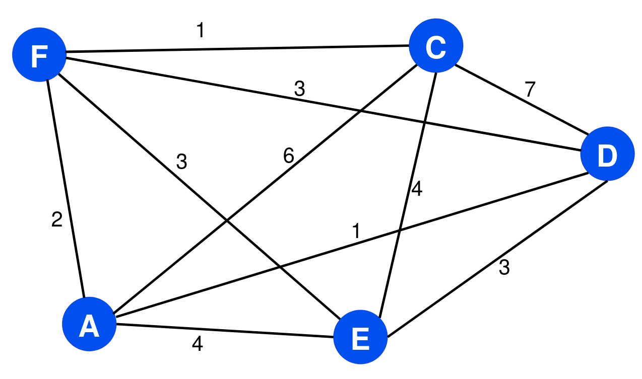
What is the Traveling Salesman Problem?
Optimal:
Complete, weighted graph
Visit every vertex once, except start
Find least cost path

Slide 3

Optimal vs Decision
Optimal:
Decision:
Visit every vertex once, except start
Find a tour that visits each city exactly once, total cost ≤ k
Find least cost path
returns a yes or no answer to this
F→C→E→D→A→F
Cost: 11

Slide 4
Certifier Process
A certificate is just a given tour, e.g.:
Tour: F→C→E→D→A→F
Verifier checks:
Does the tour visit every city once?
Does it return to the starting city?
Is the total weight ≤ k?
This takes O(n) time → polynomial.

Slide 5
Certifier Process
create array seen[1..n] initialized to false
total = 0
for i = 1 to n-1:
u = tour[i]
v = tour[i+1]
if no edge (u,v) exists:
return REJECT
total = total + w(u,v)
if no edge (tour[n], tour[1]) exists:
return REJECT
total = total + w(tour[n], tour[1])
n-constant time steps:
perform one weight lookup for each of the n edges
perform one addition per edge
all constant-time operations for n
T(n) = n ⋅ O(1) = O(n)

Slide 6
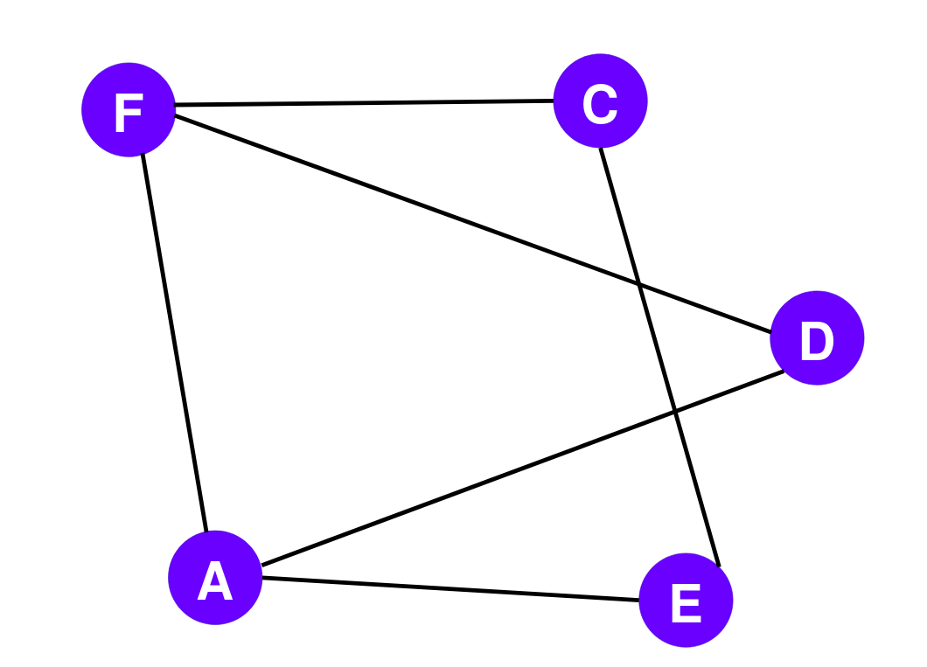
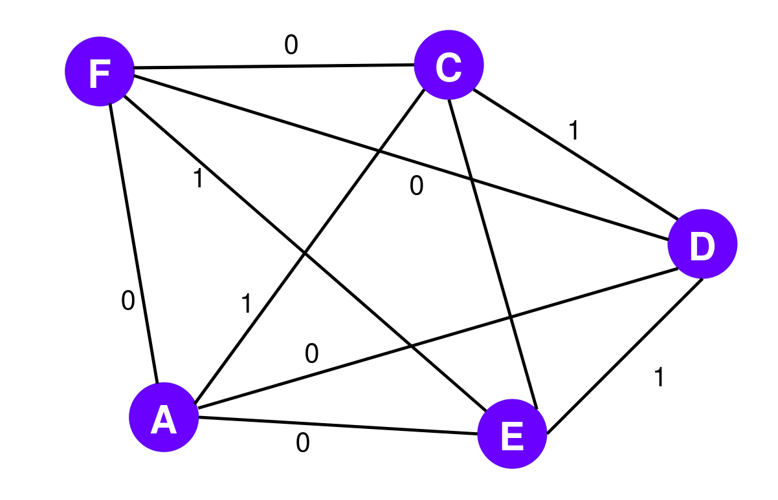
Reduction
Hamiltonian Cycle
Traveling Salesman Problem

Slide 7
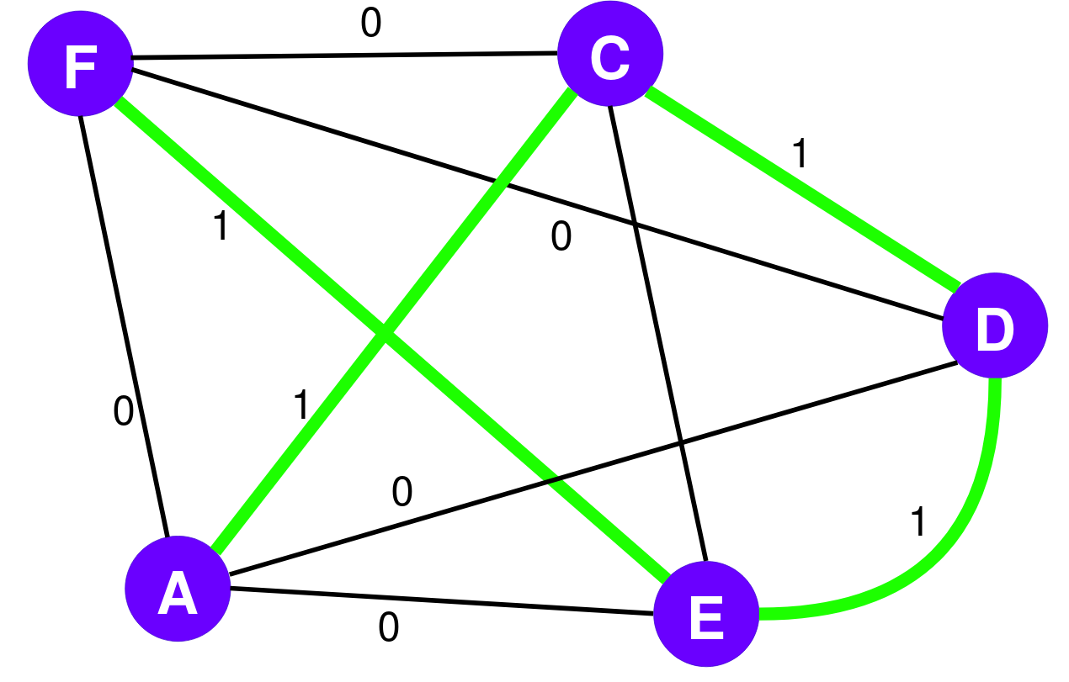

Reduction
Let G′ be a new graph with edges between all pairs of vertices
Edges present in G assigned weight 0, new edges in G′ assigned weight 1
Constructed in polynomial time

Slide 8
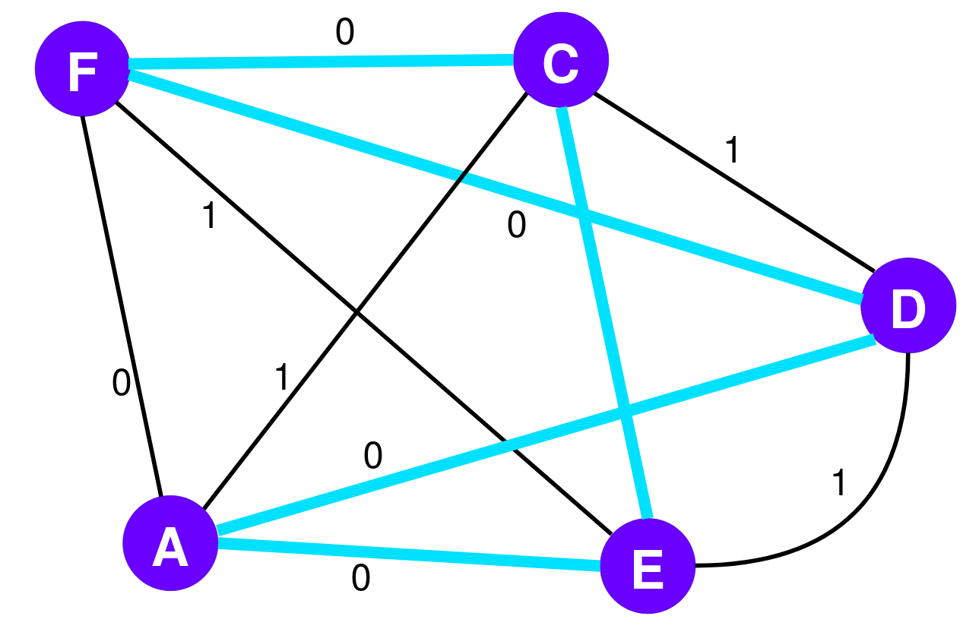
Reduction
Graph G has HC if cycle in G′ passes through all vertices once, and has length of 0
Cycle contains only edges originally present in graph G
If HC in G, it forms cycle in G′ with length of 0.
Solution exists for TSP in G′ with length of 0

Slide 9
Reduction
G′ has cycle passing through all vertices once with length of 0. This is a Hamiltonian Cycle in G.

Slide 10

Analytical Runtime
Using a brute-force algorithm for TSP, every possible tour of the cities is examined:
Dominant term:
for perm in itertools.permutations(range(1, n)) producing (n - 1)! tours
cost = sum(dist[tour[i]][tour[i + 1] for i in range(n)) is O(n) for every tour
Algorithm complexity: O(n!) factorial time, dominates everything

Slide 11
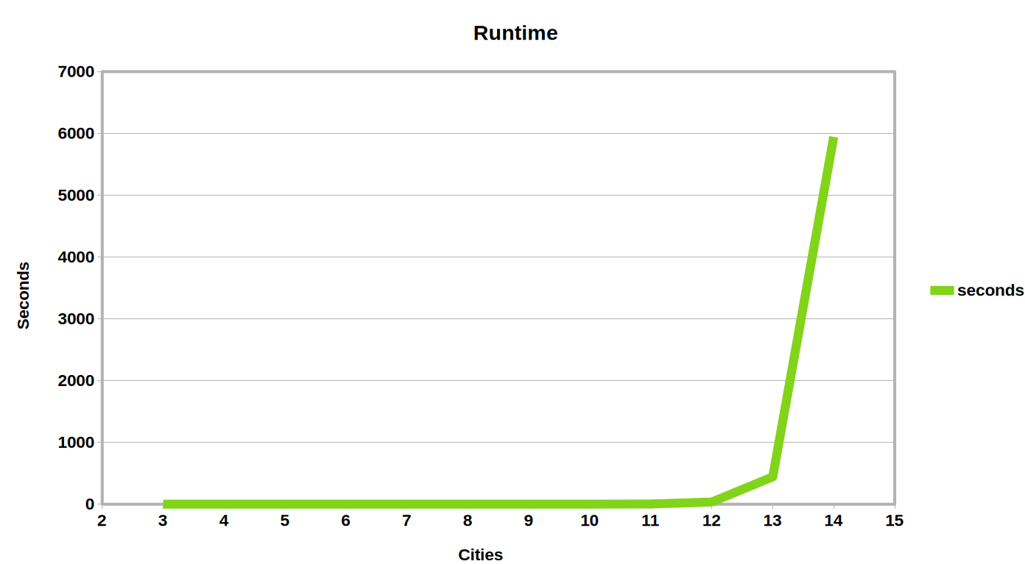

Wallclock Runtime

Slide 12
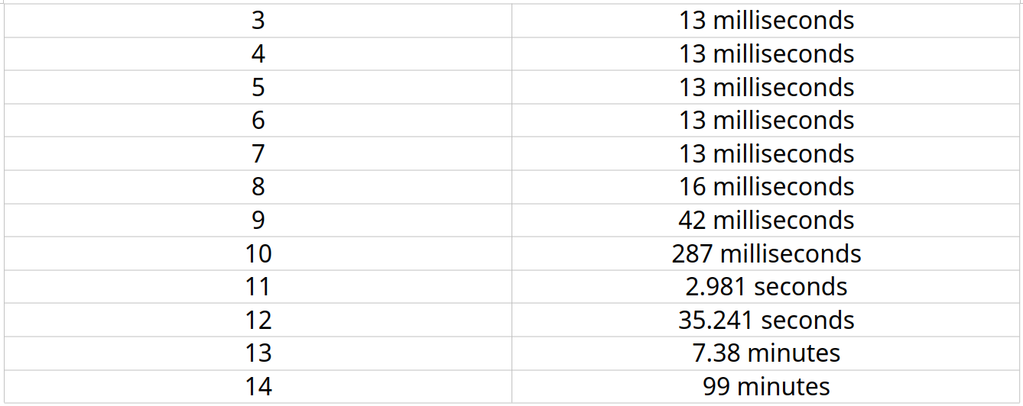
Wallclock Runtime
Input Size
Runtime

Slide 13

Approximation Solution

Slide 14



Strategy
Greedy Anytime 2-opt
With Restarts

Slide 15
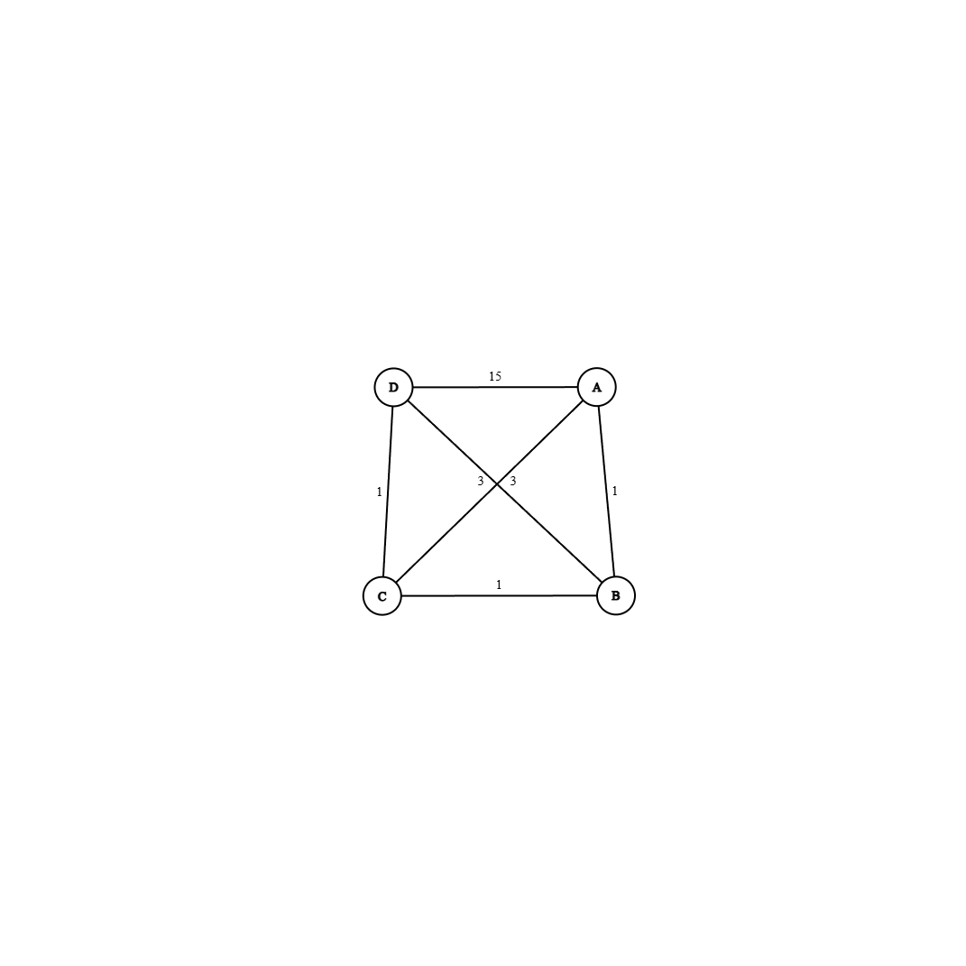
Greedy
Iteratively selects nearest unvisited neighbor
Connects back to starting node
Produces quick but (usually) nonoptimal solutions

Slide 16
Where It Can Go Wrong
Shortsighted Greediness

Slide 17
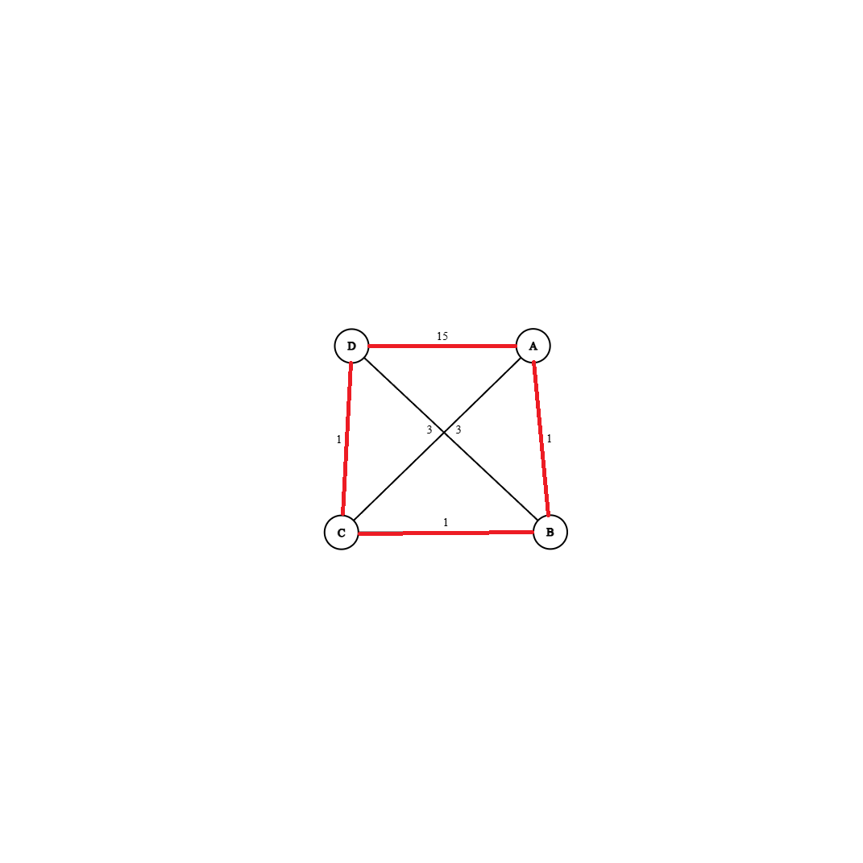
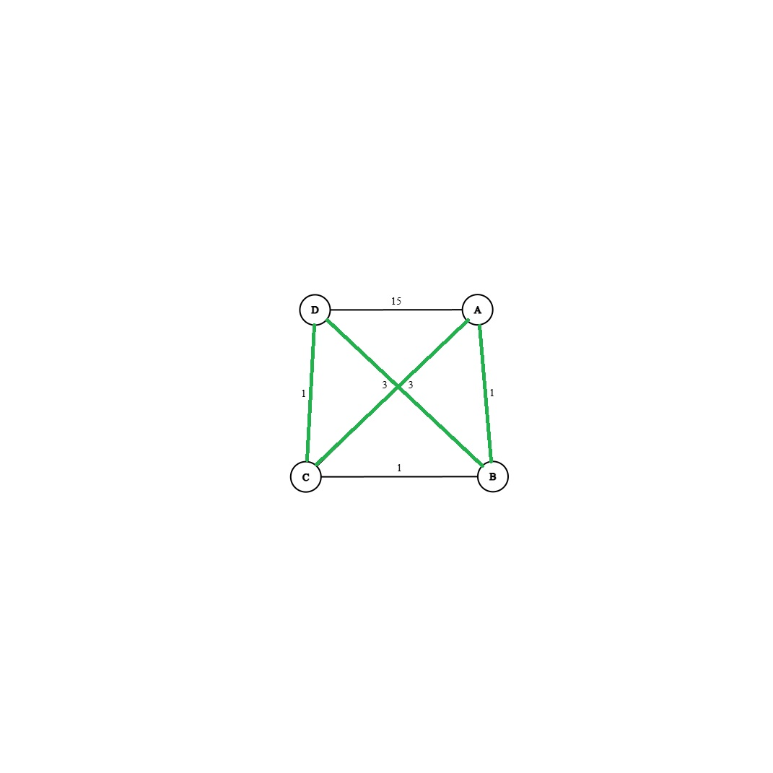


Bad Cycle
Correct Cycle

Slide 18
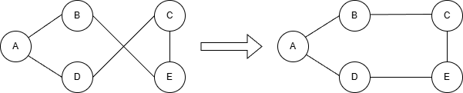
2-Opt
Uses constructed greedy tour
Looks for pairs of edges that, if swapped, shorten the path
Reverses that path segment
Continues until no improvements

Slide 19
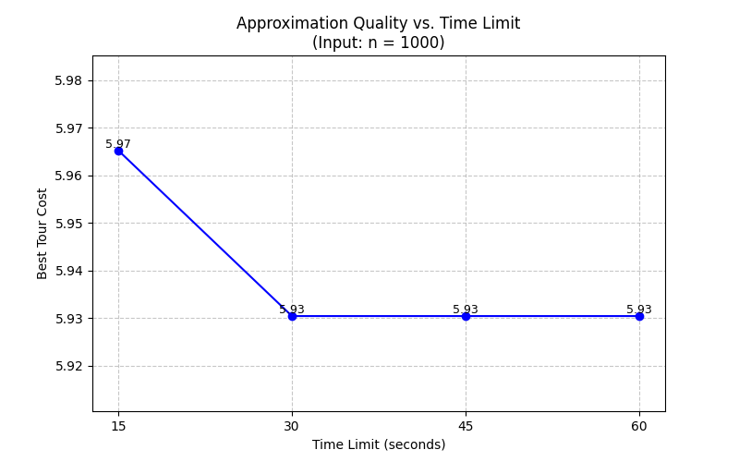
Anytime with Restarts

Slide 20



Approximation Strategy
Constructs Initial tour using Nearest Neighbor
Refines tour using 2-Opt
Repeats process with Random Start Nodes
approx(graph, deadline):
best = NULL
while time < deadline:
tour = greedy(random start node)
tour = 2-opt(tour)
if current path is shorter:
update best
return best

Slide 21

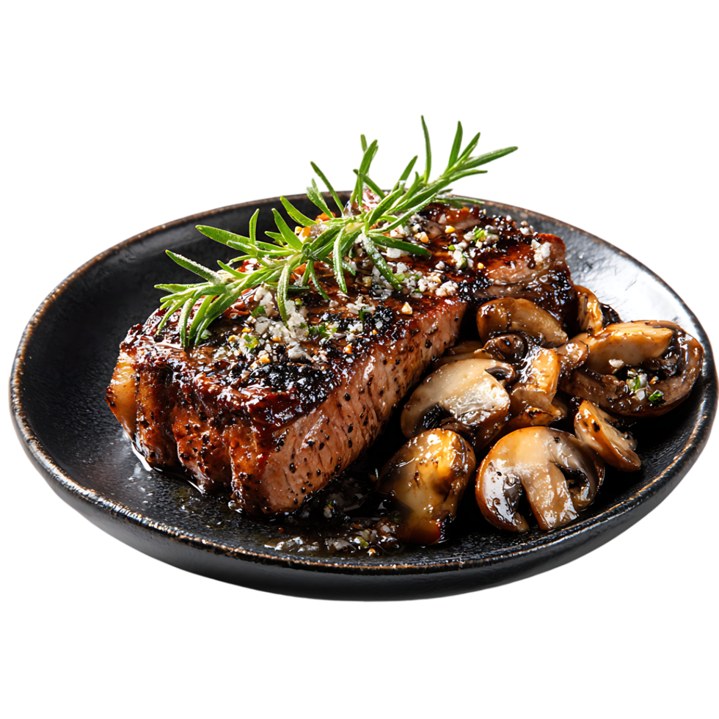
Analytical Runtime Analysis
Greedy: O(n²)
2-Opt: O(n²)
Total Complexity - O(n²)

Slide 22

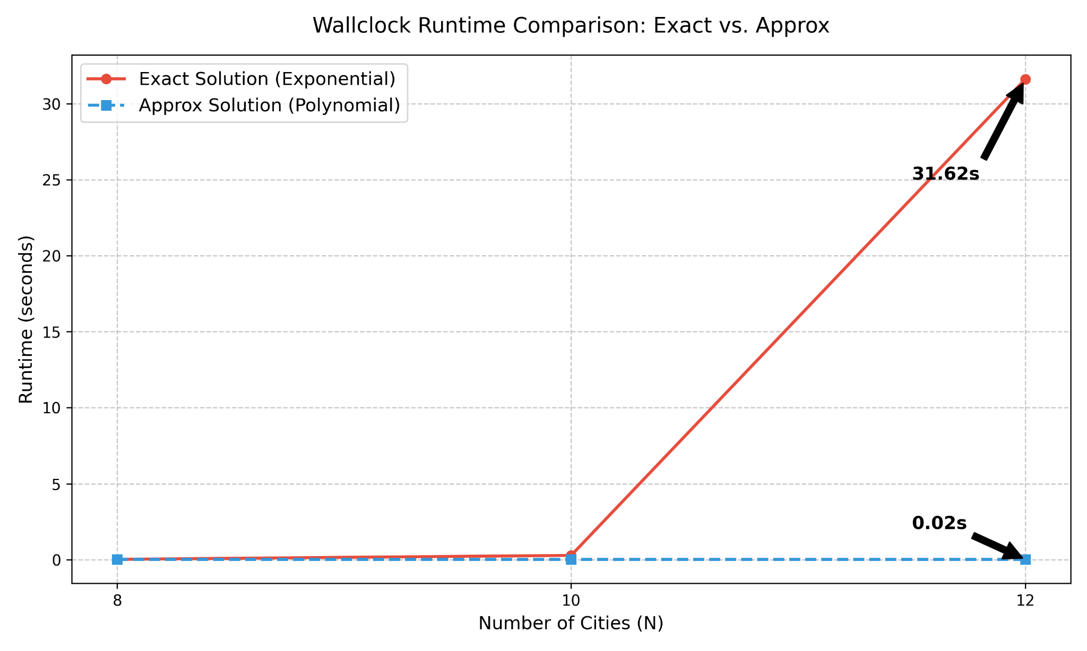
Approximate vs Exact
Wallclock Runtime Comparison: Exact vs. Approx

Slide 23
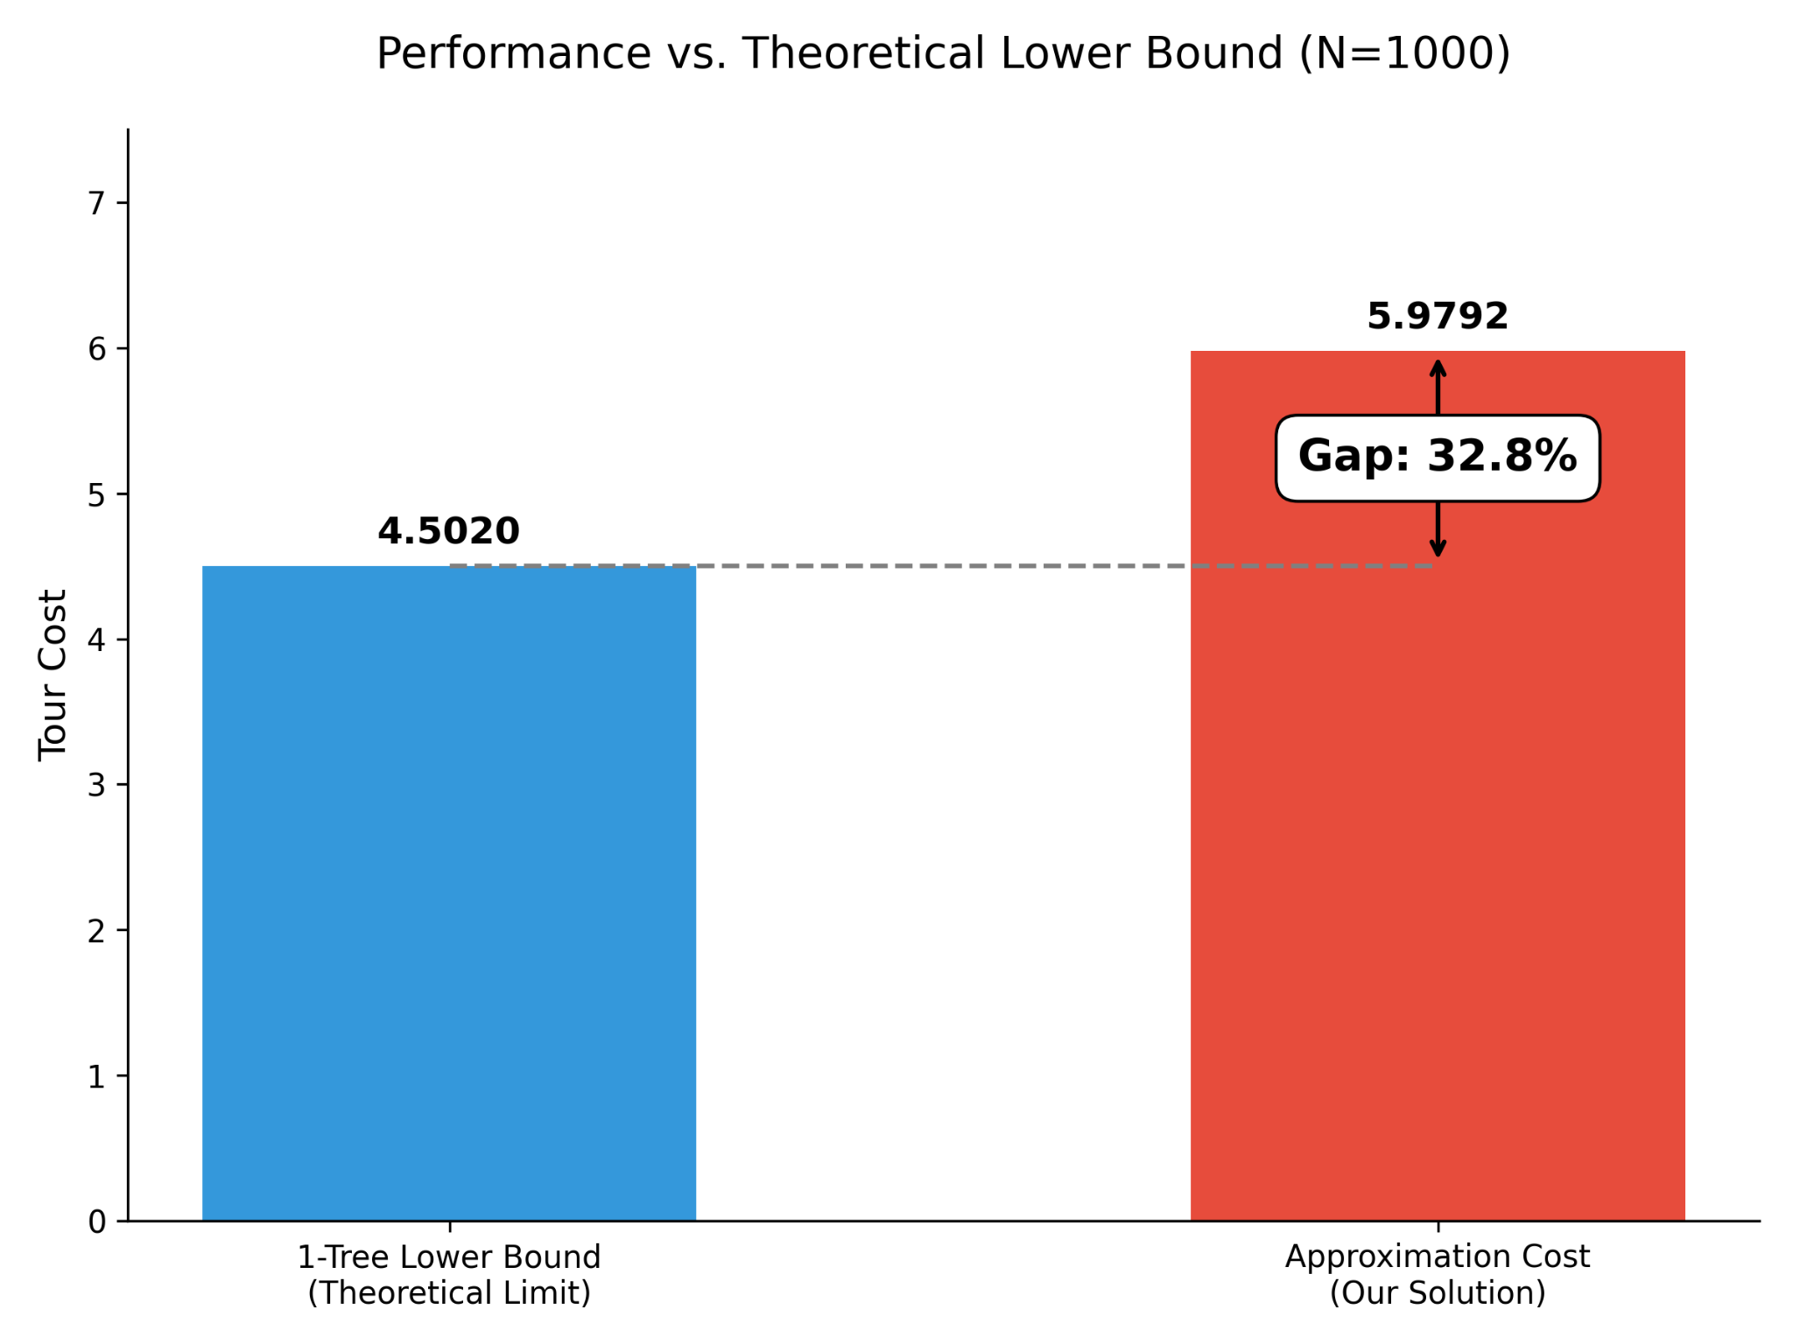
Lower Bound

Slide 24

Augment the Study
-Finding our lower bound-
Has to be:
Lower Bound cost ≤ Optimal cost ≤ Approx cost
It is important because it provides a baseline so we know how close our approximation is to our optimal
Poly time
Exp time
Poly time
Approximation Solution
Optimal Solution
Lower bound

Slide 25

How to get our lower bound – 1 tree bound
Step 1 - pick a root
Step 2 - build an MST with on all nodes except the root
Step 3 - add the two cheapest edges incident to the root
Runtime O(n² log n)

Slide 26
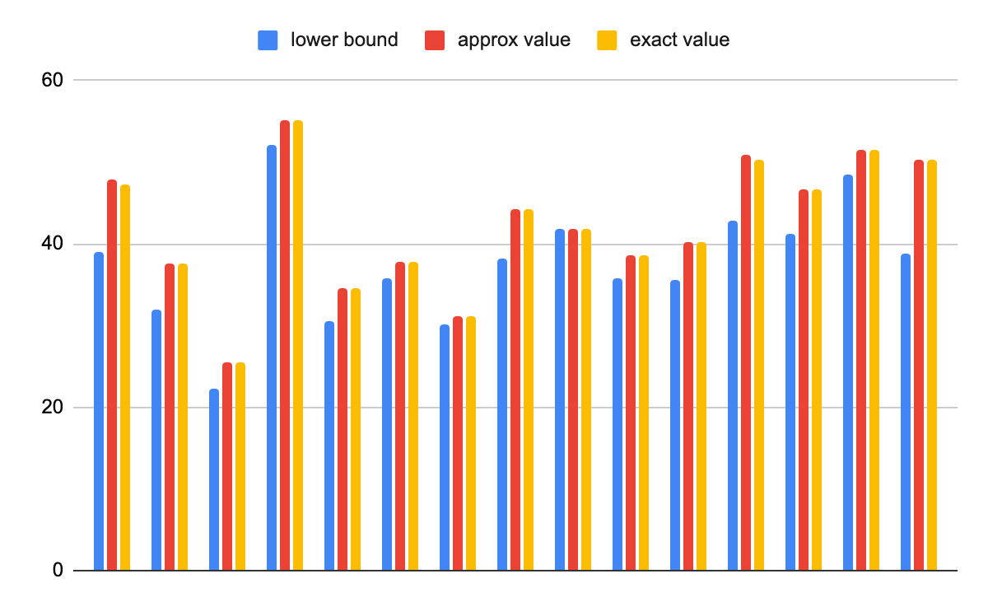
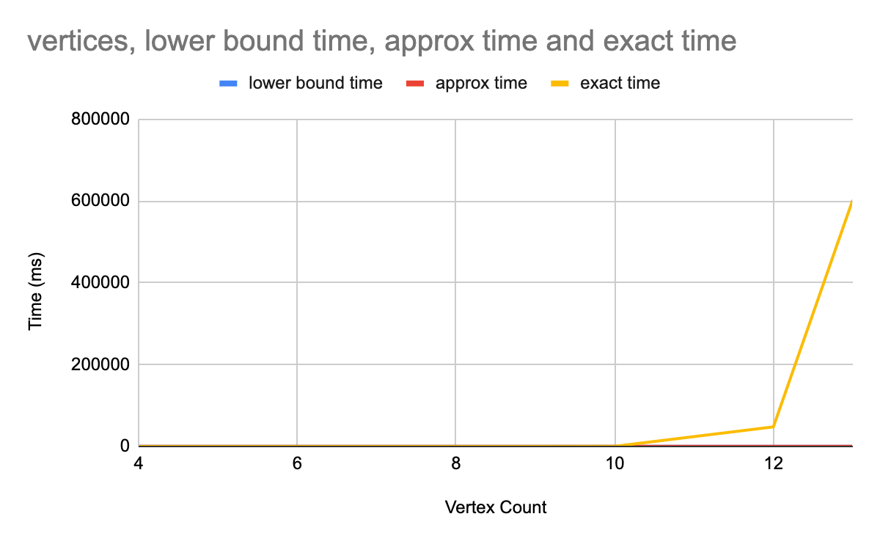
Comparing - lower bound / approx / exact-

Slide 27
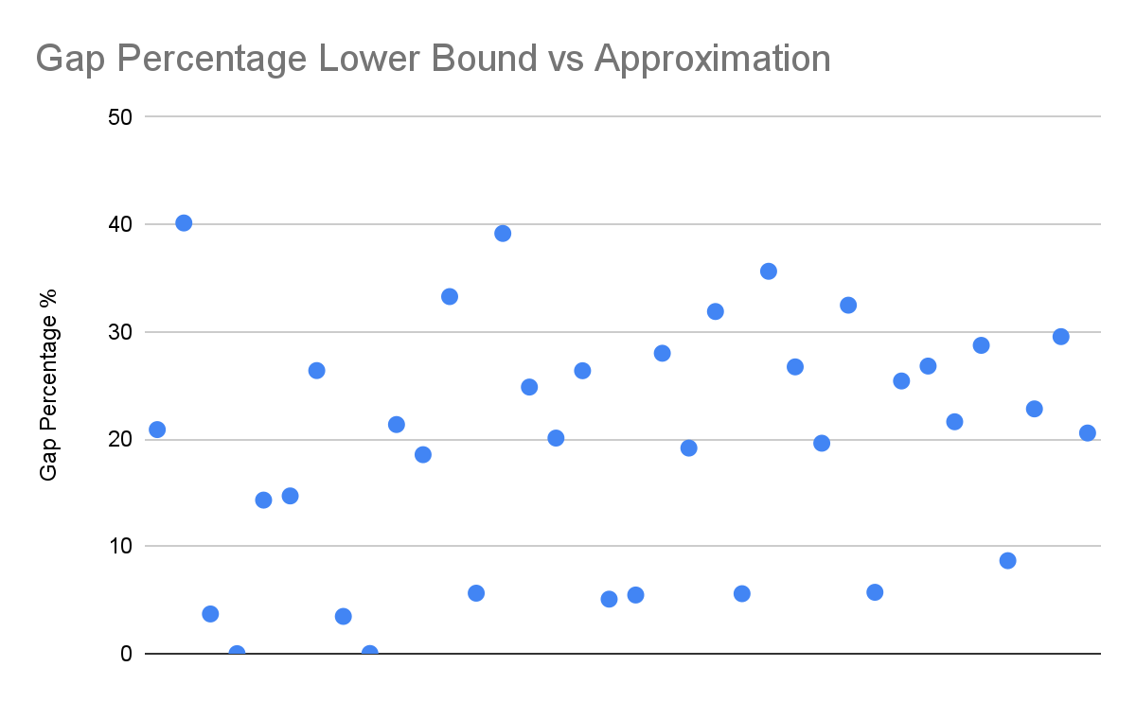

Comparing values - Gap Percentage
The average:
19.9%

Slide 28

What does this mean?

Slide 29


Thank you

